Slide 1
Python Short Class: Introduction Python For Data Analysis

Slide 2
Topic Focus Points
what and why python
Import data pandas
Data Query
Data Cleansing

Slide 3


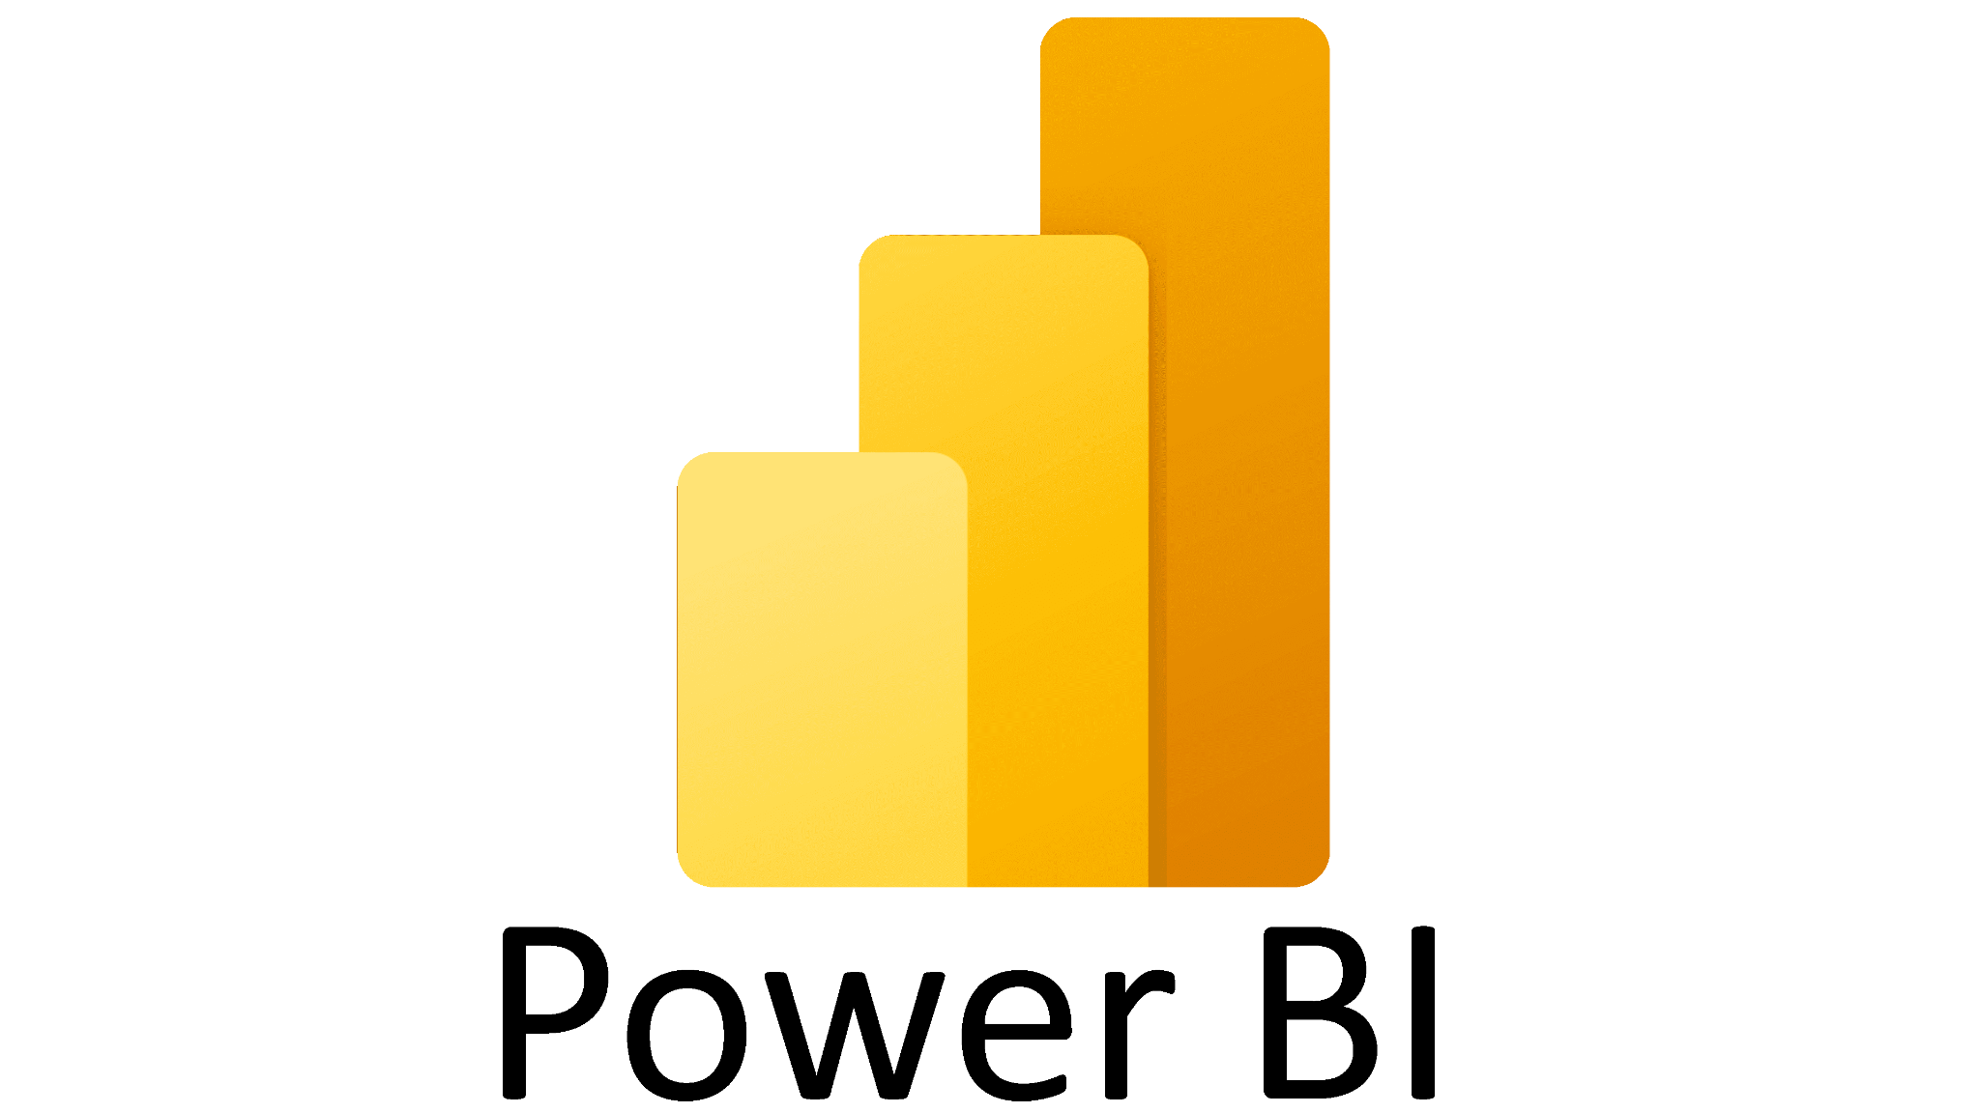




Auto-managed closed tools
Programming Languages

Slide 4
Auto-managed closed tools
Programming Languages
👎 Closed Source 🙅‍♂️
👎 Expensive 💸
👎 Limited 😩
👍 Easy to learn 👩‍💻
👍 Open Source 🤩
👍 Free (or very cheap) 🤑
👎 Extremely Powerful 💪
👎 Steep learning curve 👩‍💻

Slide 5
Python is a tools that almost all provide us to handle any activities for DA/DS/DE.
Pandas is one of the most common library that data people use.
Pandas DataFrame is data main data structure for data processing in python.
https://pandas.pydata.org/

Slide 6
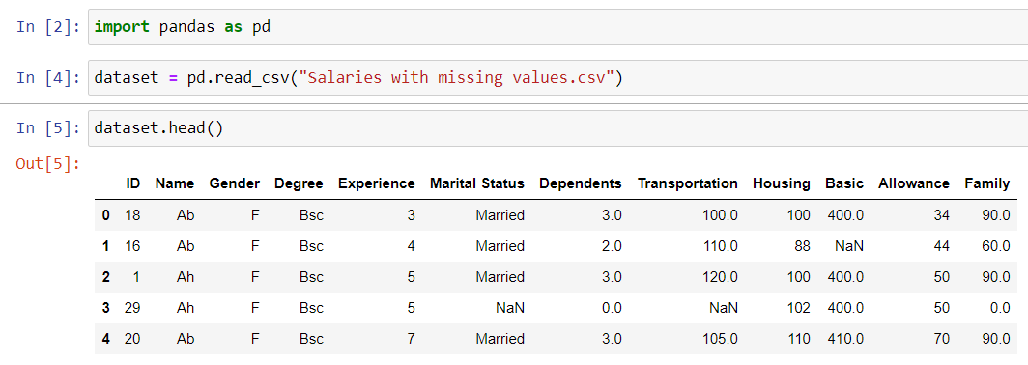
Creating a DataFrame
Others file pandas can read : xlxs, json

Slide 7
Pandas function
Columns
Index
Unique
Nunique
Dropna
Head
Tail
Value_counts
sort_values()
Isnull
Many more (https://www.javatpoint.com/python-pandas-data-operations)

Slide 8
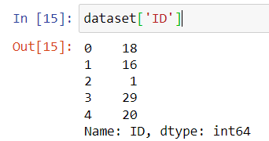
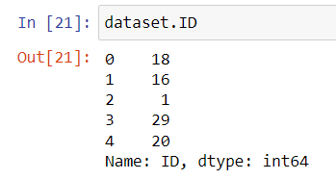
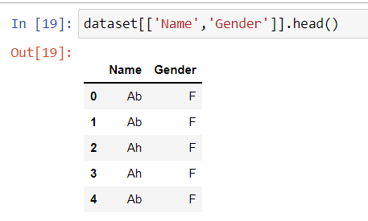
Selection and Indexing
Single selection
Multi selection

Slide 9
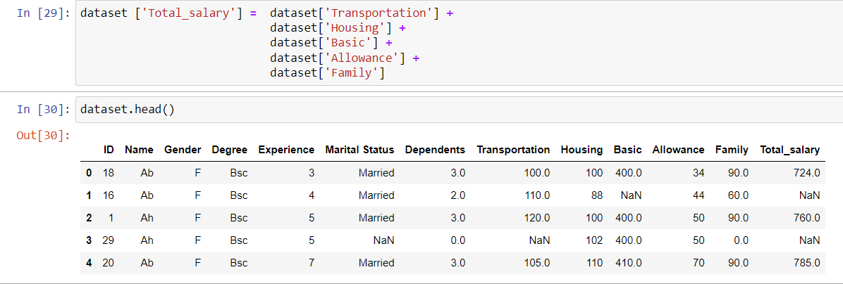
Creating a New Column

Slide 10
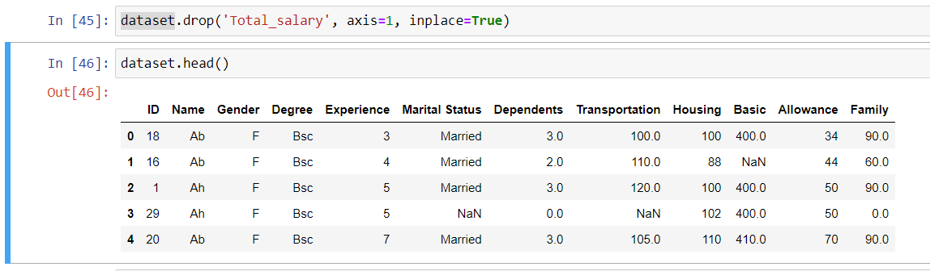
Drop a Column

Slide 11
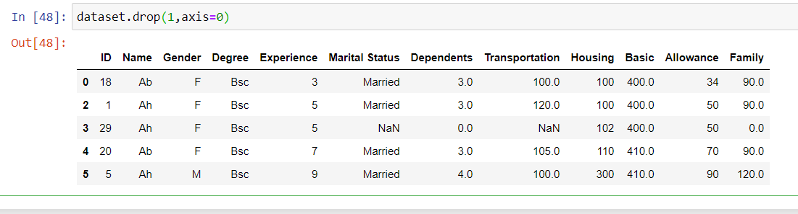
Drop a raw

Slide 12
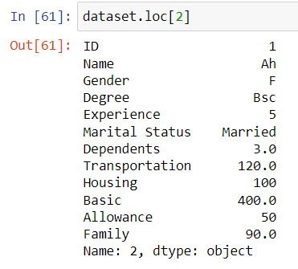
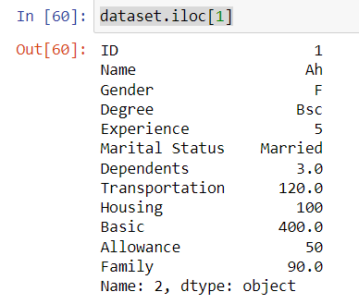
Selecting Rows (indexing)

Slide 13
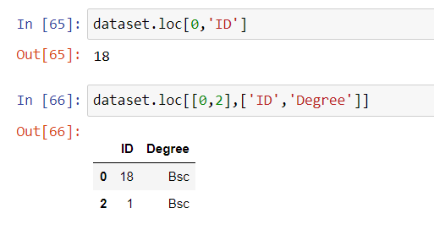
Select column and raw

Slide 14
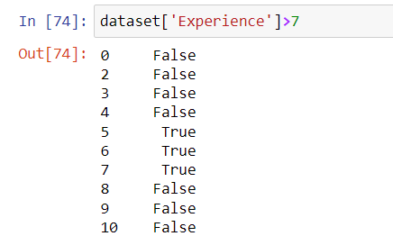
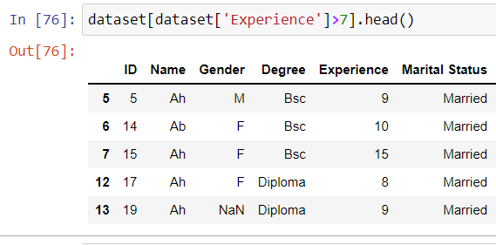
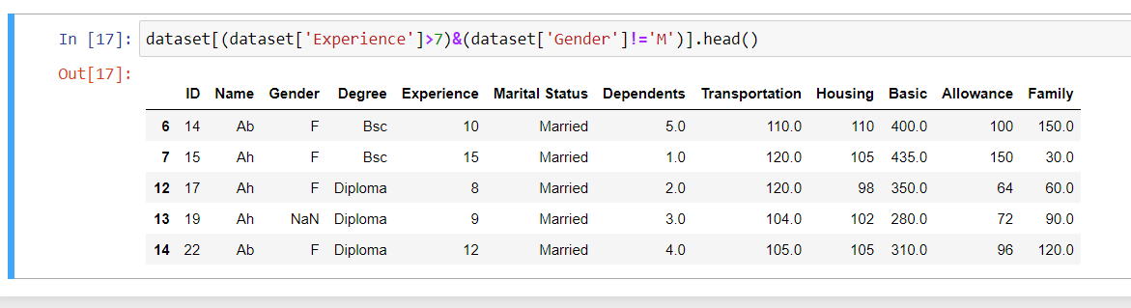
Conditional Selection

Slide 15
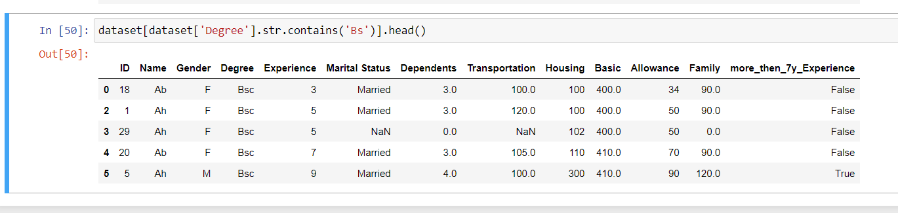
Conditional Selection

Slide 16
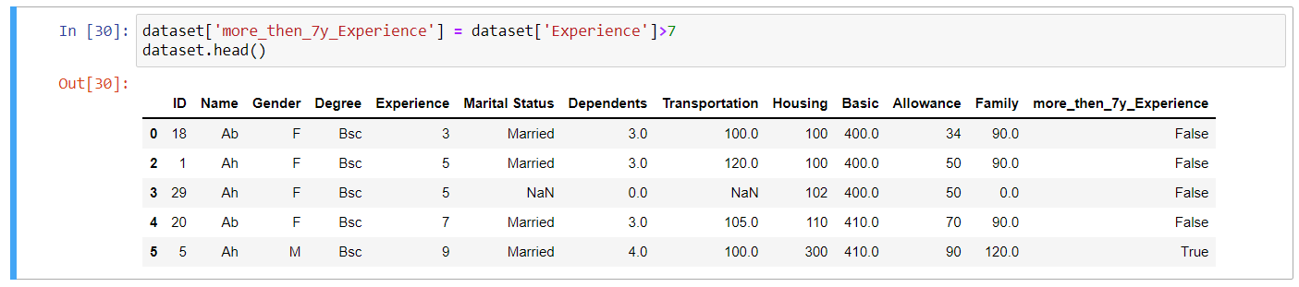
Add new column with condition

Slide 17
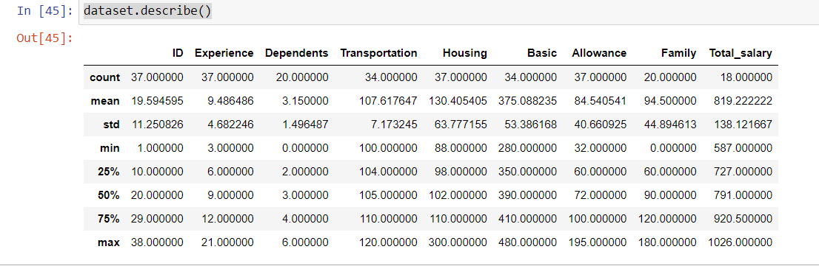
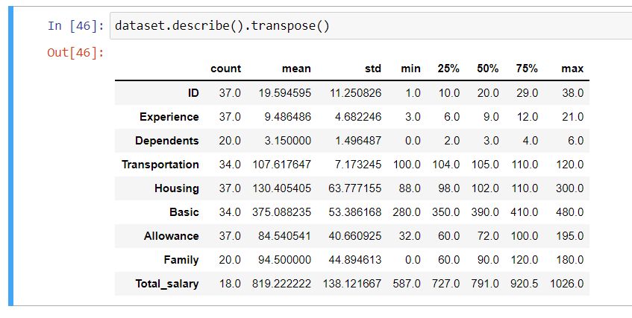
Aggregation

Slide 18
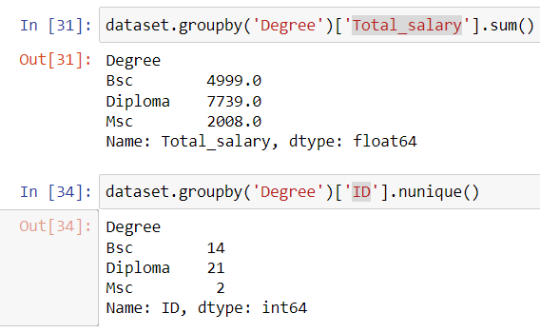
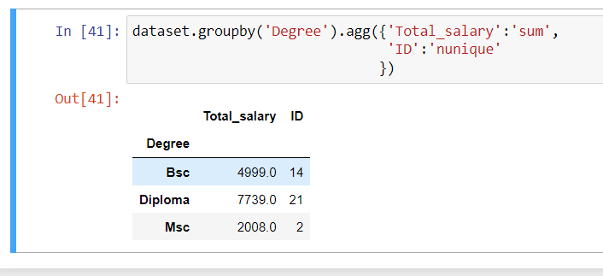
Aggregation

Slide 19
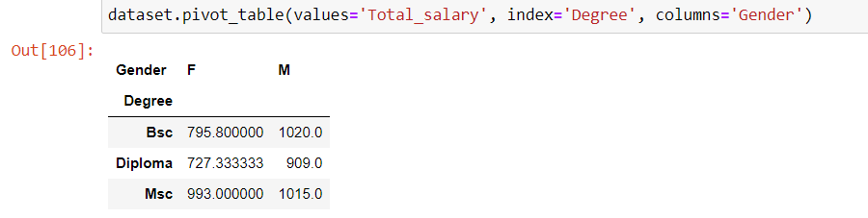
Pivot Table

Slide 20
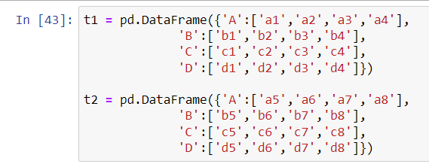
Connecting Dataframe

Slide 21
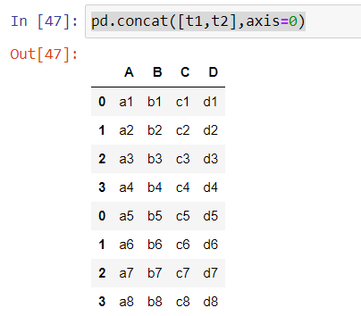
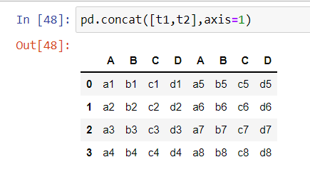
Concat

Slide 22
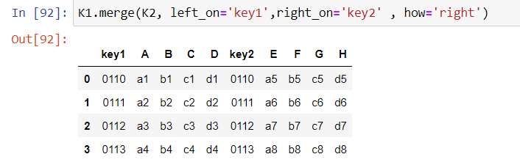
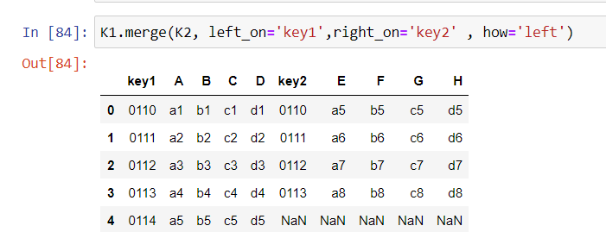
merge

Slide 23
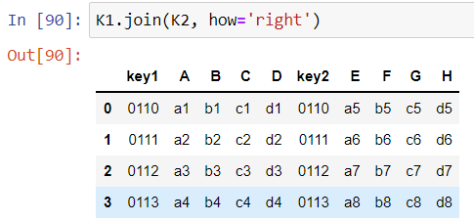
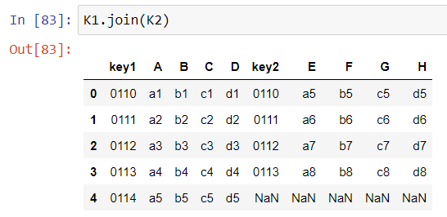
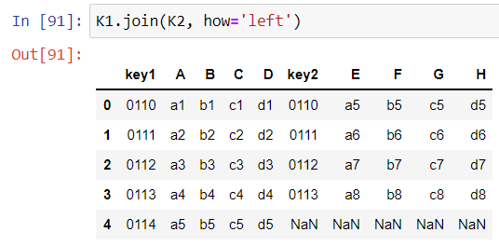
Join

Slide 24
Cleaning
Renaming Columns
Cleaning Empty Cells
Data of Wrong Format value
Discovering Duplicates
Notes:
Descriptive analytics helps answer questions about what happened. These techniques summarize large datasets to describe outcomes to stakeholders. By developing key performance indicators (KPIs,) these strategies can help track successes or failures. Metrics such as return on investment (ROI) are used in many industries. Specialized metrics are developed to track performance in specific industries. This process requires the collection of relevant data, processing of the data, data analysis and data visualization. This process provides essential insight into past performance.
Diagnostic analytics helps answer questions about why things happened. These techniques supplement more basic descriptive analytics. They take the findings from descriptive analytics and dig deeper to find the cause. The performance indicators are further investigated to discover why they got better or worse. This generally occurs in three steps:
Identify anomalies in the data. These may be unexpected changes in a metric or a particular market.
Data that is related to these anomalies is collected.
Statistical techniques are used to find relationships and trends that explain these anomalies.
Predictive analytics helps answer questions about what will happen in the future. These techniques use historical data to identify trends and determine if they are likely to recur. Predictive analytical tools provide valuable insight into what may happen in the future and its techniques include a variety of statistical and machine learning techniques, such as: neural networks, decision trees, and regression.
Prescriptive analytics helps answer questions about what should be done. By using insights from predictive analytics, data-driven decisions can be made. This allows businesses to make informed decisions in the face of uncertainty. Prescriptive analytics techniques rely on machine learning strategies that can find patterns in large datasets. By analyzing past decisions and events, the likelihood of different outcomes can be estimated.

Slide 25
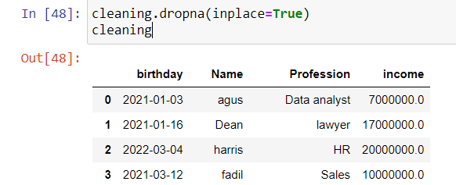
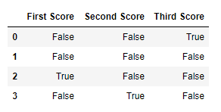
Cleaning Empty Cells
df.isnull()

Slide 26
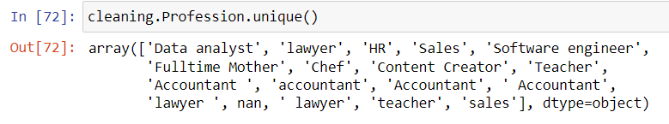
Data of Wrong Format value

Slide 27
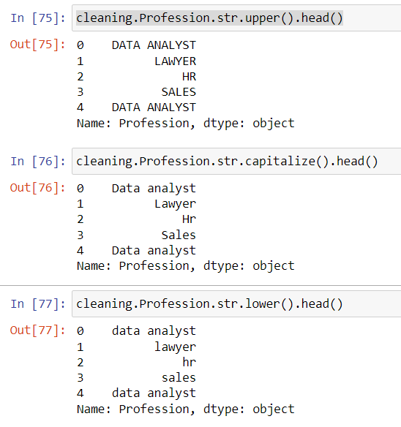
String manipulation function - upper() - lower() - capitalize() - strip()

Slide 28
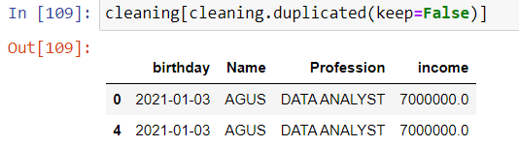
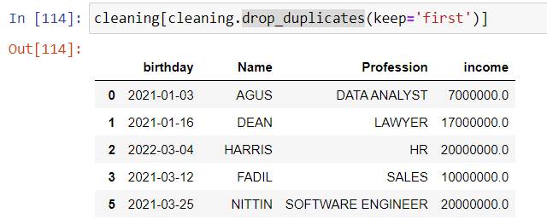
Discovering Duplicates
duplicated()
drop_duplicates()

Slide 29
Thank you!

